Slide 1
數位IC設計
Pei-Yin Chen, 陳培殷
資訊工程系 特聘教授兼電機資訊學院副院長

Slide 2
Syllabus (1/2)
Time and Place
  Tuesday : 9:10 ~ 12:00 Rm.4264
Contact Information
  資訊系11F Rm:65B13 (06-2757575 EXT 62547)
  E-mail: pychen@csie.ncku.edu.tw
Office Hour
  Monday: 8:00~12:00
Assistants
  資訊系10F 數位IC設計實驗室(65A01)
  陳威廷 weiting84610@gmail.com

Slide 3
Syllabus (2/2)
評分方式: 考試(30~50%)
作業含Demo(60~40%)
    平常成績(10%)
參考書目：
教育部P&L聯盟課程講義– FPGA系統設計實務
HDL chip design (Douglas J. Smith), Doone Publications
3. Principles of digital design (Daniel D. Gajski), Prentice Hall
4. Modeling, synthesis, and rapid prototyping with the Verilog HDL (Michael.
D. Ciletti), Prentice Hall
5. 數位IC設計--Verilog,(陳培殷),滄海書局

Slide 4
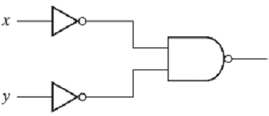
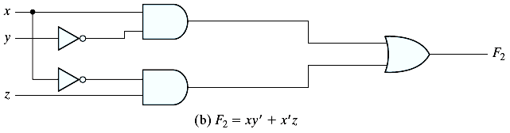
Digital System
input
digital circuit
0
1
1
0
digital circuit
digital circuit
digital circuit === IC (integrated circuit)
semiconductor

Slide 5
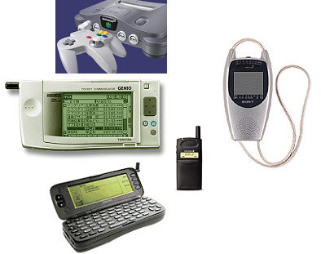
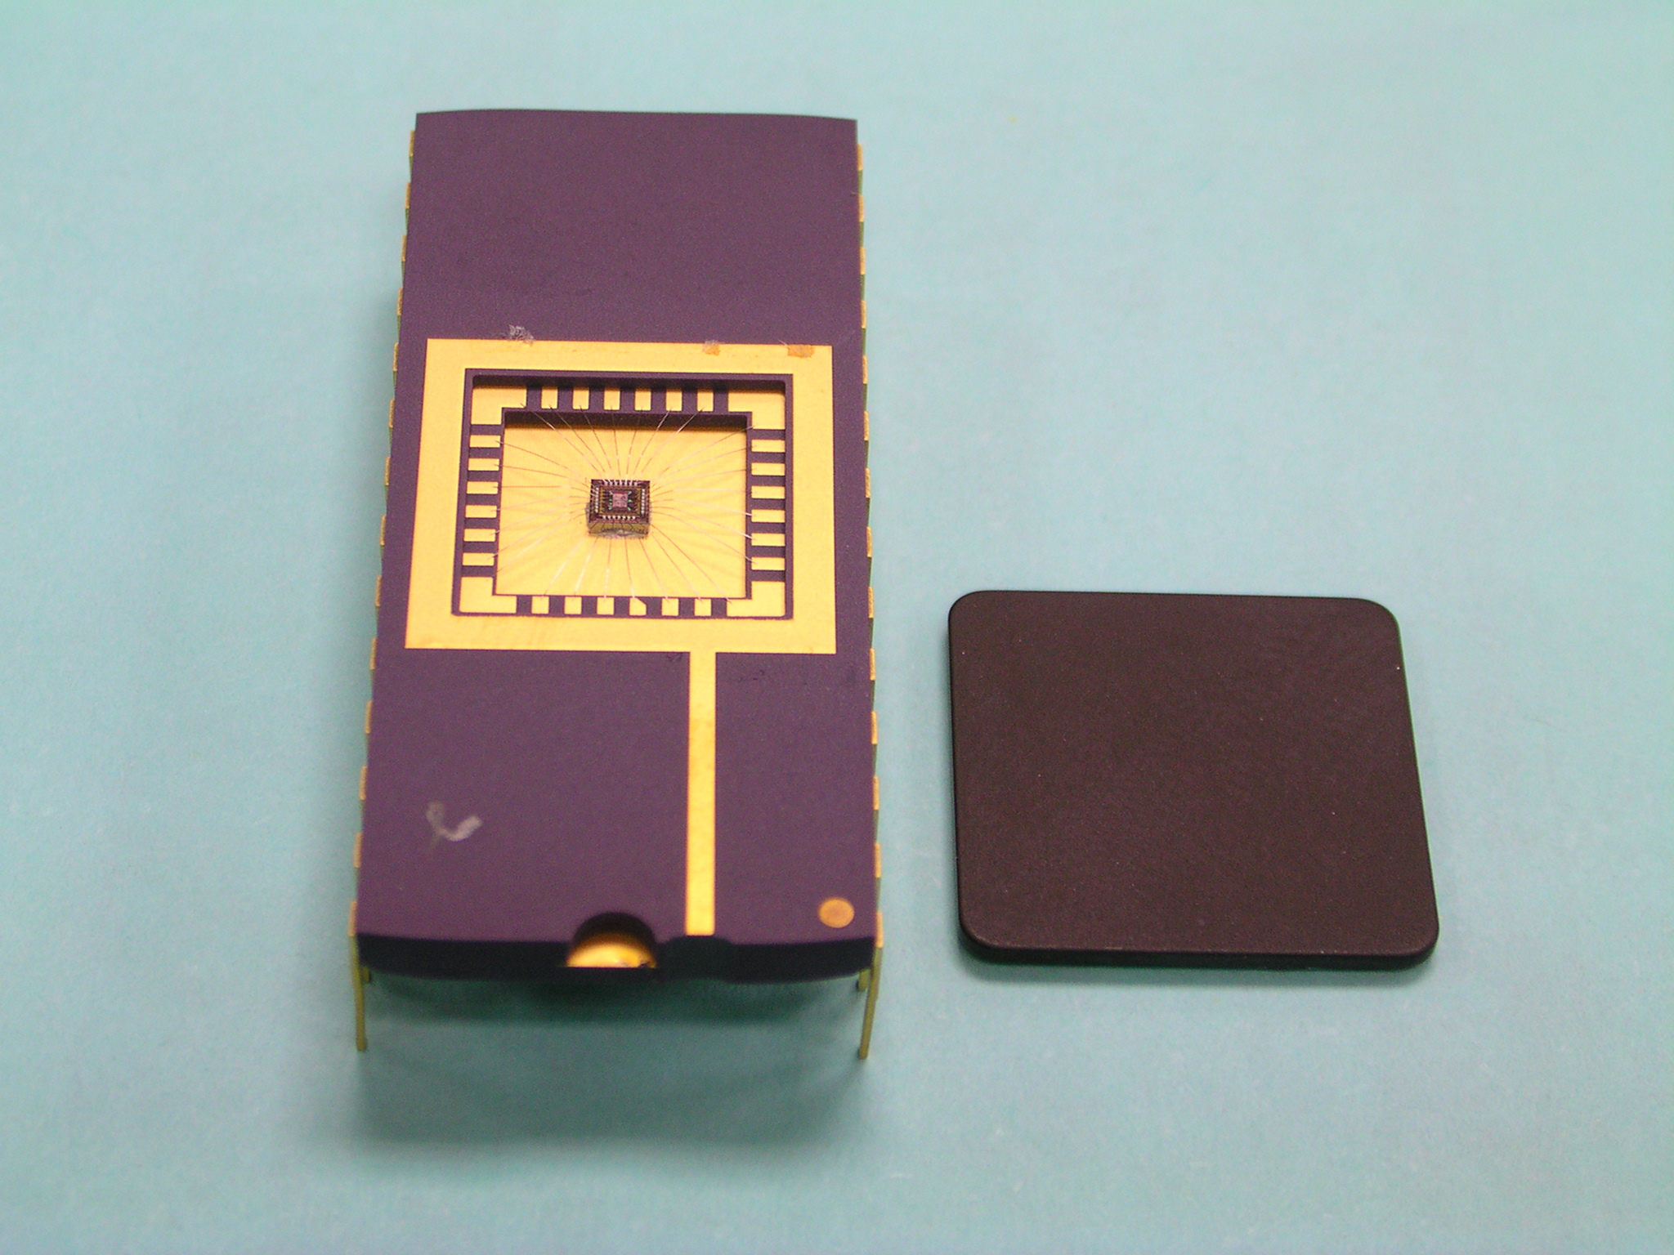
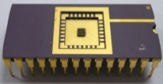
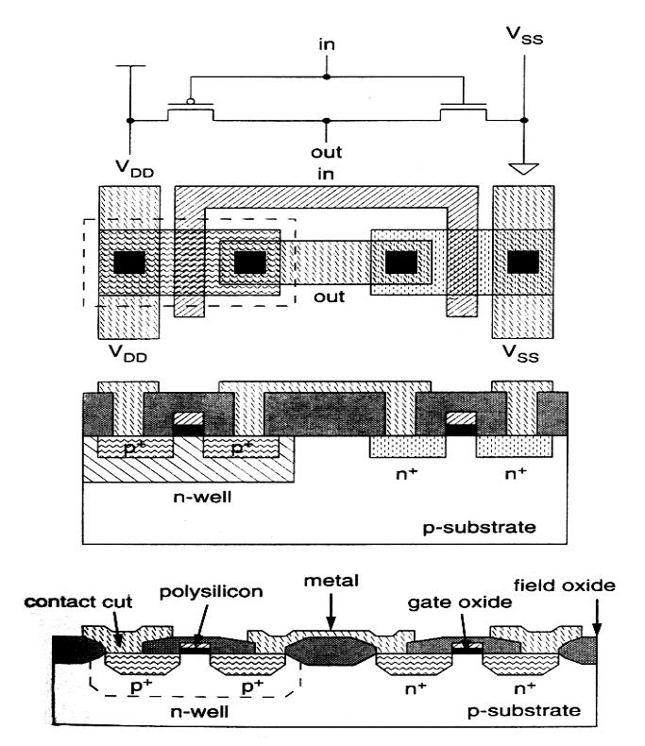

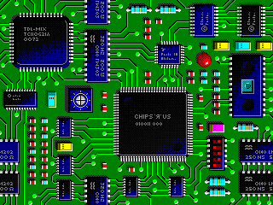
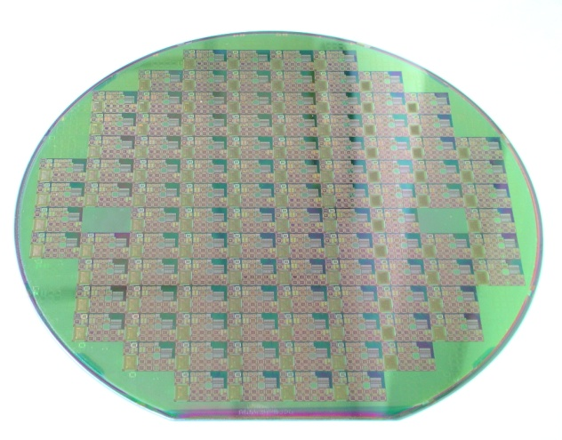
Chip/Circuit Everywhere!
Applications

Slide 6
Circuits
Transistor
Gate ( 1 gate ~= 2~14 transistors)
A combination of interacting transistors
Circuit
A combination of interacting gates designed to accomplish a specific logical function
IC (Integrated Circuit)
System➔ PCB (printed circuit board)
SoC (system on a chip) ➔ How many gates in a chip?

Slide 7
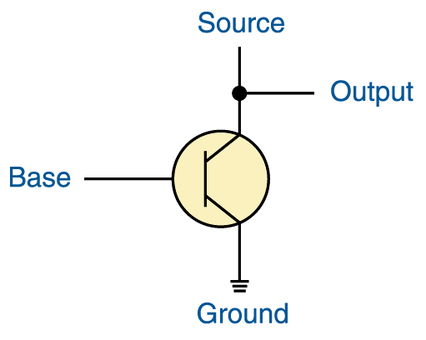
Transistor(電晶體)
+5 volts
A transistor has three terminals
  A source (feed with 5 volts)
  A base
  An emitter, typically connected to a ground wire
If the base signal is high (close to +5 volts), the source signal is grounded and the output signal is low (0). If the base signal is low (close to 0 volts), the source signal stays high and the output signal is high (1)

Slide 8
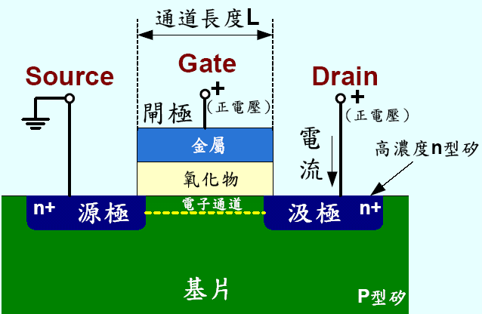
N-channel MOS Transistor
Transistor (電晶體)– Semiconductor(半導體)

Slide 9
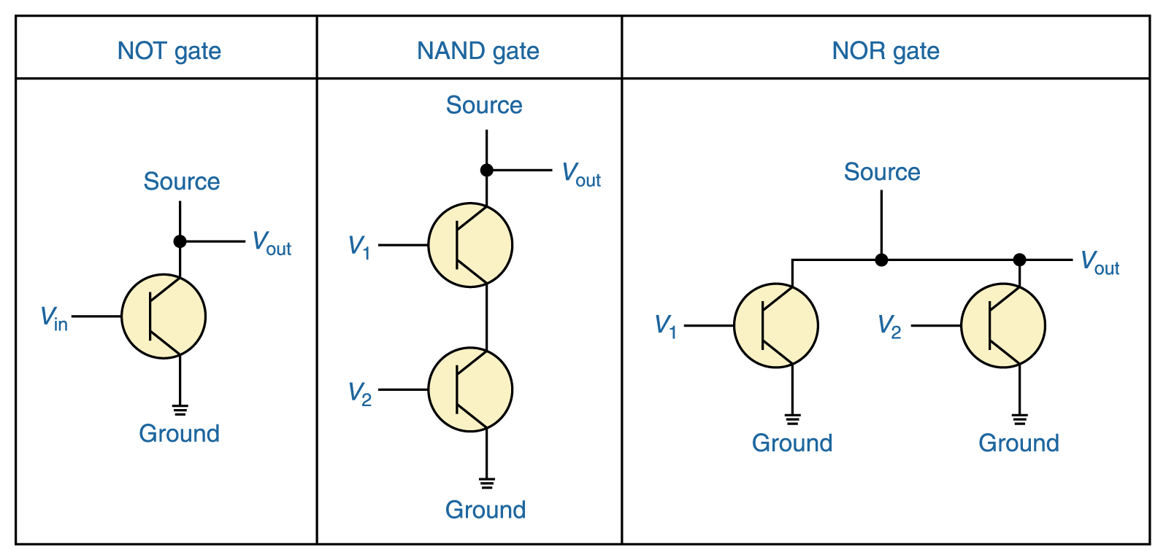
Constructing Gates (semiconductor)
It turns out that, because the way a transistor works, the easiest gates to create are the NOT, NAND, and NOR gates
V₁ V₂ V_{out}
0 0 1
0 1 1
1 0 1
1 1 0
V₁ V₂ V_{out}
0 0 1
0 1 0
1 0 0
1 1 0
V_{in} V_{out}
0 1
1 0

Slide 10

IC Design (with CMOS)
CMOS Inverter
in
out
One npn transistor
and one pnp transistor
are used to construct
one inverter.
done by
chip designer
masking
done by
TSMC, UMC
Packing, Testing

Slide 11
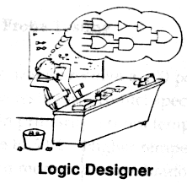
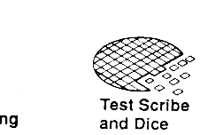
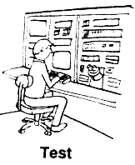

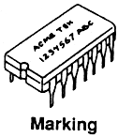
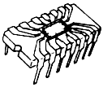

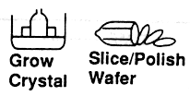
IC Industry in Taiwan
邏輯設計
光罩設計
晶粒測試及切割
封 裝
成品測試
設計
光罩
製造
封裝
測試
長晶
晶圓切割
導線架
晶圓
化學品

Slide 12
IC Design flow
IC design flow
Full Custom
Semi Custom (Cell-Based Design)
Standard Cells:
TSMC, UMC-cells
b. FPGA or PLD Programmable logic:
Xilinx, Altera, Actel-cells
ASIC
Full (Fully) Custom Design:
For analog circuits and digital circuits requiring custom optimization
Gates, transistors and layout are designed and optimized by the engineer
Semi Custom Design:
For larger digital circuits
Real gates, transistors and layout are synthesized and optimized by
related software tools
c. Realization with hardware description language (HDL) such as VHDL and
Verilog

Slide 13
Goal of Course
Digital IC Design
Cell-Based Design
Verilog
PC-based simulation

Slide 14
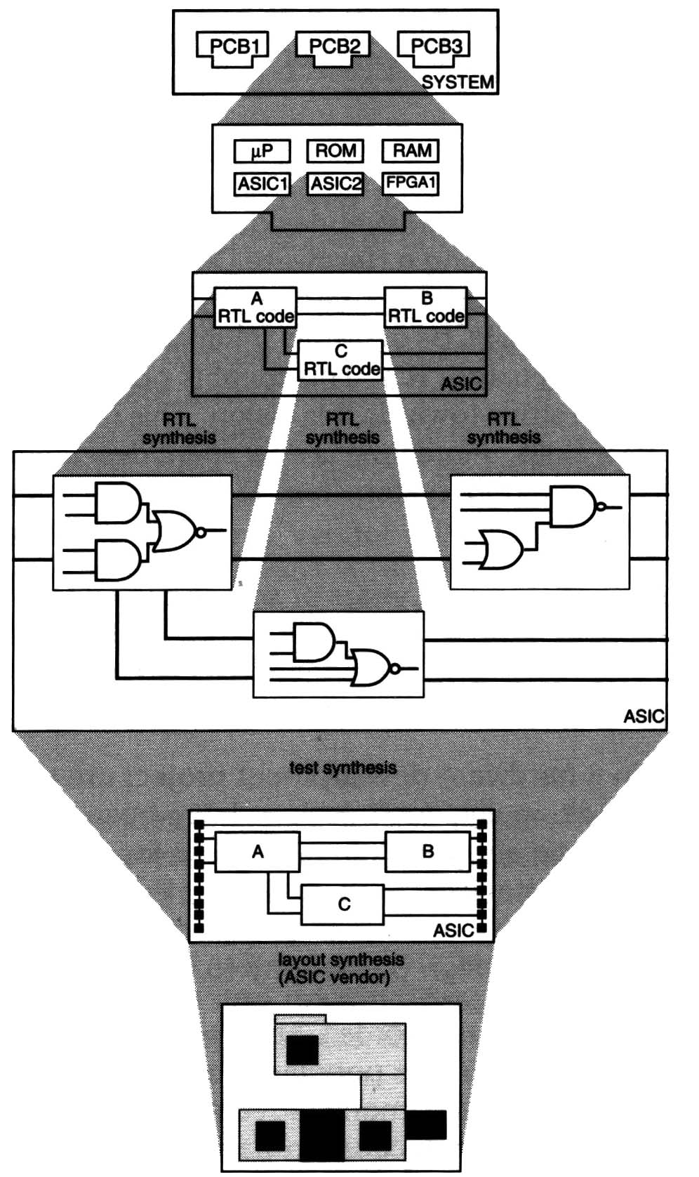
Hierarchical Components in PCB
Describe the circuits with
Hardware Description Language
(HDL硬體描述語言)
2. Synthesis (合成) the circuits
….
application specific integrated circuit
(ASIC晶片)

Slide 15
Synthesis
Synthesis = Translation+Optimization+Mapping
always @(…)
if (a==b)
if (c==1)
d=f;
else
d=1;
else
d=0;
Translate into Boolean Representation
a
f
b
d
Optimize + Map
HDL Source
c
f
c
d
a
Process of logic synthesis
b
Target Technology

Slide 16
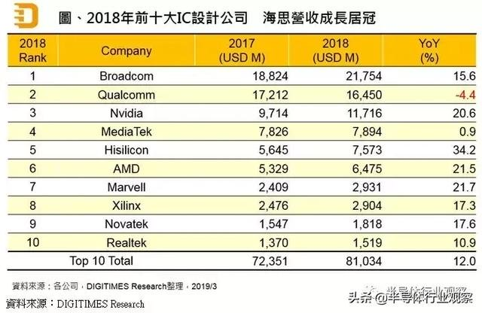
2018 Top 10 Fabless IC Suppliers

Slide 17
2019台灣IC設計公司營收
排名 | 公司 | 2019 (K NTD) | 註解
1 | 聯發科 | 246,222,731
2 | 聯詠 | 64,372,306
3 | 瑞昱 | 60,744,006
 | 群聯 [*] | 44,693,441 | IC 設計佔 25% 左右
 | 擎亞 [*] | 22,788,153 | 電子通路
4 | 奇景光電 | 20,529,600 | 估 672 M USD
5 | 瑞鼎 | 13,931,466
6 | 矽創 | 13,802,738
7 | 慧榮 | [估]13,000,000 | 估 424 M USD
8 | 晶豪 | 10,952,222
9 | 創意 | 10,710,068
 | 新唐 [*] | 10,367,269 | 有晶圓廠
10 | 義隆 | 9,487,977

Slide 18
Outline
Chapter 1: Introduction
Chapter 2: Semi Custom Design Flow
Chapter 3: RTL Coding-Part I
Chapter 4: RTL Coding-Part II
Chapter 5: Digital System Design
Chapter 6: Control Unit
Chapter 7: Datapath
Chapter 8: Case Study
Chapter 9: System on a Chip
Chapter 10: Low-Power Design

